Slide 1
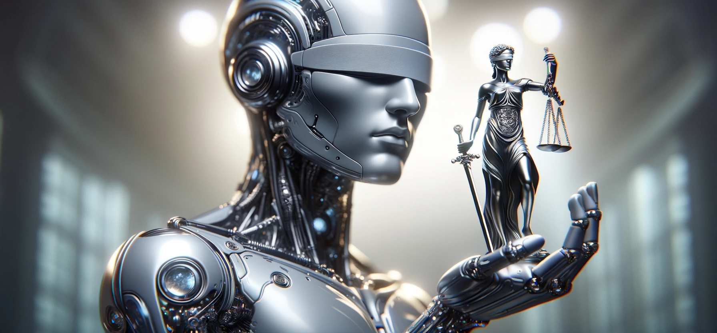
Regulating in an Uncertain Future-AI and Beyond
18 April 2024

Slide 2
Evolving AI Regulatory
Landscape
Notes:
Hand over to Michael

Slide 3




Different approaches to regulation
‘Vertical’
sector based,
regulator led
‘Vertical’
sector based,
market led
‘Horizontal’
use case based,
legislator led

Slide 4
Regulating AI in the
UK
Notes:
Hand over to Michael

Slide 5
Regulating AI: UK definition
UK National AI Strategy -
AI Action Plan
18 July 2022
Rt Hon Nadine Dorries MP
Secretary of State for Digital, Culture, Media and Sport
Rt Hon Kwasi Kwarteng MP
Secretary of State for Business, Energy and Industrial Strategy
Adaptable
but not autonomous (analysis fed to human decision maker – e.g. diagnostic medicine)
Adaptable & autonomous
(e.g. self driving car, NLP directly interacting on internet)
More adaptable = greater risk that machine will be unknowable. Potential for unexpected emergent properties or behaviours
Neither autonomous nor adaptable
(most legacy software)
Autonomous but not adaptable
(clear, knowable if-this-then-that decisions e.g. ATM, supermarket self checkout etc.)
More autonomous = greater risk that harms will arise without oversight. Potential for incorrect decisions to go unchallenged

Slide 6
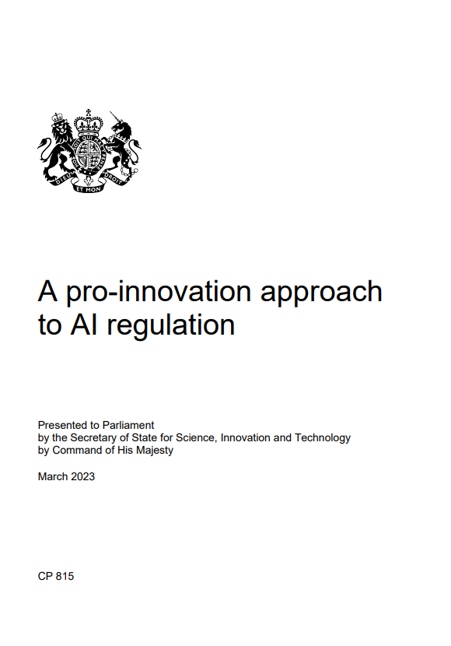
UK AI Regulation White Paper
Key features of the UK's proposed approach – March 2023
'De-centralised' approach
Regulator led (e.g., FCA; ICO)
Regulators enforce common principles for responsible AI
Emphasis on international standards
UK policy agenda – AI summit; global watchdog??
The Rt Hon Michelle Donelan MP,
Secretary of State for Science, Innovation and Technology

Slide 7
Regulating AI in the
US
Notes:
Hand over to Michael

Slide 8

A New US AI Regulatory Landscape…
ChatGPT’s impact on the general public coupled with warnings of “existential risk” by leading academics and industry leaders have prompted global urgency to regulate.
In Washington DC, Senate Majority Leader Chuck Schumer in April announced a framework for regulating artificial intelligence and has called for “comprehensive bipartisan legislation.”
Similar to the EU’s data privacy law (GDPR) that serves as the de-facto global privacy regulatory standard, the EU’s AI Act signals hard law AI regulation on the horizon, possibly by the end of the calendar year.
The Biden Administration hosted an AI Summit with generative AI tech leaders in May indicating White House recognition of the urgency to act on AI.
Common themes for emerging regulatory requirements of AI systems: Transparency and Explainability, Accuracy, Robustness and security, Accountability, Human values and fairness
Notes:
Sector based – similar to UK
But in divisive election year have coincidence of position between demos and repubs calling for MORE regulation
Although, each has slightly different angle
One of a few areas not opposed
Too much money and potential for harms perceived by trad voters
Unformfortable talking points from chatgpt…

Slide 9
US Executive Order
30th October 2023
Overall aim: Safe, secure, and trustworthy AI
Red-teaming, AI testbeds, and industry standards – NIST to develop new standards.
The Defense Production Act: to ensure safe, reliable, and effective AI / esp. dual use tech
Privacy: Americans’ privacy and civil liberties must be protected as AI advances
Cybersecurity: must be addressed in addition to privacy measures
Federal Trade Commission (FTC) and Federal Communications Commission (FCC): AI affects consumers and network infrastructure
Intellectual property: patents and copyright implications of AI
Health: protection against harms to patients
Chemical, biological, radiological, and nuclear (CBRN) threats: AI plus other tech particularly with regard to biological weapons.
Competitive practices and innovation
Immigration: easier access to US for skilled workers
Education: Development of an AI Toolkit
Housing: Prevention of bias and discrimination in access to housing
Labor: a worker-centric approach.
Notes:
All the greatest hits again
Not directly effective outside the fed government (not AI reg in that sense)
Item 9 – US fearing open source could create risks that responsible commercial AI wouldn’t

Slide 10
Regulating AI in the
EU
Notes:
Hand over to Michael

Slide 11




Regulating AI: EU Definition
“machine-based system designed to operate with varying levels of autonomy and that may
exhibit adaptiveness after deployment and that, for explicit or implicit objectives, infers,
from the input it receives, how to generate outputs such as predictions, content,
recommendations, or decisions that can influence physical or virtual environments”
AI
Transformative
Influence
Simulation of human intelligence processes by machines
Revolutionising business operations
Rapid development and exponential growth
2

Slide 12
EU AI Act - an update
Two and a half years on…
19 February 2020 - Commission’s “White Paper on AI”
21 April 2021 Commission’s Draft “AI Act”
17 June 2022 - First Compromise Proposal
6th Dec 2022 – Council adopts its text
Parliament adopts its text May 2023
Trilogues July – Jan 2024: Political Agreement reached – 8th Jan 2024
Parliament votes 13 March 2024 – passes overwhelmingly
OJEU publication expected April / May ‘24
Notes:
Extra territorial effect
If results are used in EU – you’ll be caught, wherever you’re operating from
Relecant to all big tech

Slide 13

Timeline – staggered implementation
EU Parliament Votes
Entry into the OJ
Prohibited AI systems
Codes of Practice
13 March 2024
April / May
2024
6 months
9 months
12 months
18
months
24
months
36
months
Guidance
Annex 3 high risk
Annex 2 high risk
GPAI rules apply

Slide 14
EU AI Act
A comprehensive, risk-based Regulation for persons selling (as a product or service) and using AI
Title IV: Transparency Obligations for Providers and Deployers
Title V: Measures in Support of Innovation
EU AI Act
Title III: High-Risk AI Systems
Title VI-VII: Governance & Implementation
Title II: Prohibited AI Practices
Title IX: Codes of Conduct
Title I: Scope & Definitions
Title X: Penalties

Slide 15

General Principles
These elements apply at all times if you fall within the scope of the AI Act. In other words, even if you aren’t performing a prohibited activity, or using a high-risk AI system or a foundation model, these key concepts will apply
AI literacy
Human agency and oversight
Technical robustness and safety
Privacy and data governance
Transparency
Diversity, non-discrimination and fairness
Social and environmental wellbeing
AI literacy includes teaching the basic notions and skills about AI systems, different types of products and uses, including their risks and benefits to staff and other users of the system. AI literacy can be considered a general minimum level of awareness and understanding of the risks and potential issues associated with using AI systems
Notes:
Article 4a, 4b(2), (3) and (4) - Unofficial consolidation text adopted by EP on 14 June 2023

Slide 16
EU AI Act
A comprehensive, risk-based Regulation for persons selling (as a product or service) and using AI
Key definitions | % total worldwide annual turnover
Providers | Organisations that creates or commissions the creation of AI systems or models, and then markets or uses them, regardless of whether they charge for it or not.
Deployers | Organisations that uses an AI system for any purpose other than personal, non-professional activities.
General Purpose AI | An AI that can handle many different tasks effectively, developed with extensive data and self-learning techniques. It's versatile for various applications but doesn't include models still in research or development phases
Prohibited Practices | Very harmful AI use cases that are entirely prohibited under the AI Act.
High Risk | Potential harmful AI use cases that required significant governance and compliance controls to manage.
Activity | % total worldwide annual turnover | Euro fine
Prohibited practices | 7% | 35,000,000
High risk AI systems | 3% | 15,000,000
Other breaches | 1% | 7,500,000

Slide 17
Prohibited AI Practices
Subliminal techniques beyond a person’s consciousness with the objective to or effect of materially distorting a person’s behavior
… which causes physical or psychological harm
Exploiting any of the vulnerabilities of a specific group of persons due to their age, disability, or social or economic situation
… which causes physical or psychological harm
Social scoring: evaluating or classifying individuals based on their social behavior or known or predicted personal or personality characteristics
‘Real-time’ biometric identification systems in publicly accessible spaces by law enforcement
… although exceptions apply

Slide 18
High Risk AI
What is High Risk AI?
Biometric identification and categorisation of natural persons
Management and operation of critical infrastructure
Education and vocational training
Employment, workers management and access to self-employment
Access to and enjoyment of essential private services and public services and benefits
Law enforcement
Migration, asylum and border control management
Administration of justice and democratic processes
The AI System is a safety component of products/products themselves governed by the Union Harmonisation Legislation

Slide 19
Most GPAI models will only need to comply with documentation requirements
Applicability
Rules
Rules for GPAI
Majority of models
Keeping technical documentation about the training and testing process
Publishing information for downstream users of the GPAI (who intend to integrate the GPAI into their own AI system)
Creating a policy to respect union copyright law
Publishing a summary of content used for the training of the model
Applies to all GPAI models
Rules for GPAI with systemic risk
Additional rules applying only to systems with “high impact capabilities” or where Commission determines so
Performing risk assessments to identify and mitigate systemic risk including at Union level
Monitoring, documenting and reporting serious incidents
Implementing adequate cybersecurity

Slide 20
Requirements for High Risk AI Systems
A significant burden
Risk Management
High Quality Data Sets and Data Governance
Technical Documentation
Record Keeping
Transparency by Design
Human Oversight
Accuracy, Robustness and security
Conformity Regime
Requirements
Conformity Assessments
Maintain compliance
Quality Assurance Systems
Registration in EU database
CE Marking
Ongoing Monitoring
This summary is only of the AI Act requirements for high risk AI. Many other laws will engage (e.g. GDPR and data protection laws; e.g. employment laws; e.g. anti-trust) which will need to be considered.

Slide 21

AI Common Ground
AI is in the process of being regulated in many countries
Common themes can be identified around
Transparency and Explainability
Accuracy
Robustness and security
Accountability
Human values and fairness
Exposure to fines, sanctions, claims for compensation and reputational risk, including arising under existing laws
Risk of duplication of effort and inefficient use of resources and a larger legacy problem to address
Discouraging and delaying AI adoption
Failure to manage AI risk effectively may result in:
Notes:
Big differences in approaches for UK, US, EU (china etc.)
BUT – actually the common themes are across them all

